Slide 1
UNICORN COMPANIES
AN EXPLORATORY DATA ANALYSIS

Slide 2

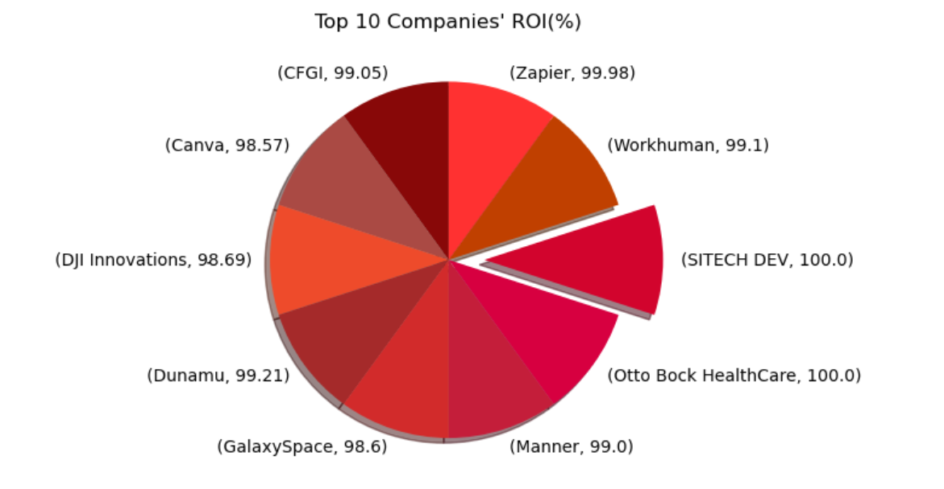
TOP 10 ROI OF UNICORN COMPANIES(%)
Observation:
- Otto Bock Healthcare and SITECH DEV came out on top in terms of Return on Investment recorded (100% : at $0 funding). That being said, there are uncertainties around the latter as its funding was previously recorded as unknown. But with further research, it was speculated that it is yet to receive any funding till date (Ref: Tracxn Technologies Private Limited, May 31, 2021)

Slide 3
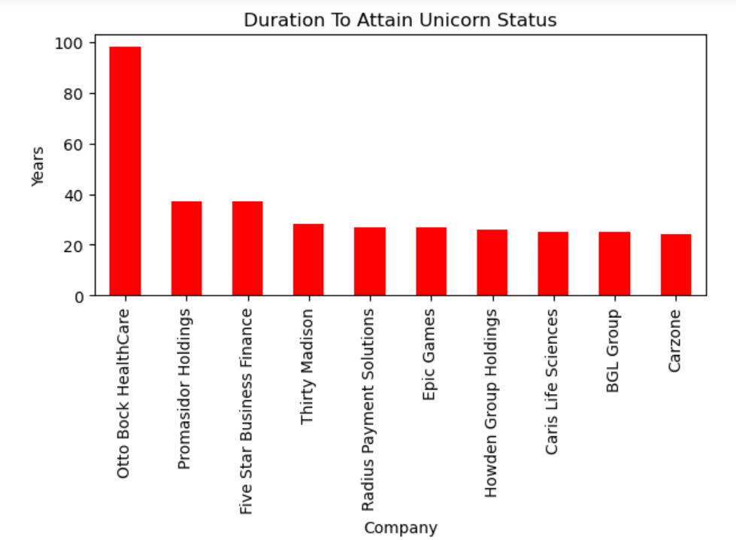
TIME TAKEN TO ATTAIN UNICORN STATUS
Observation:
- Some companies took quite a long time to attain the level of a Unicorn Company (USD 1 billion valuation), for example; Otto Bock HealthCare took 98 years to achieve this feat but Avant didn't take up to a year. There are reasons for the timing in being refered to as a Unicorn Company:
1. Tech is the fastest route to success and achieving the tag of a unicorn for most companies in this new age. Tech companies nowadays attain billion dollar valuation within a year after their inauguration - Avant for example.
2. Pertaining to the term "Unicorn" literally; it was not used in referring to billion dollar companies, not until 2013, when it was first coined by a venture capitalist Aileen Lee. The first Billion dollar company was the United States Steel Corporation in 1901 at a valuation of USD 1.4 billion, but it wasn't referred as a Unicorn at that time.

Slide 4
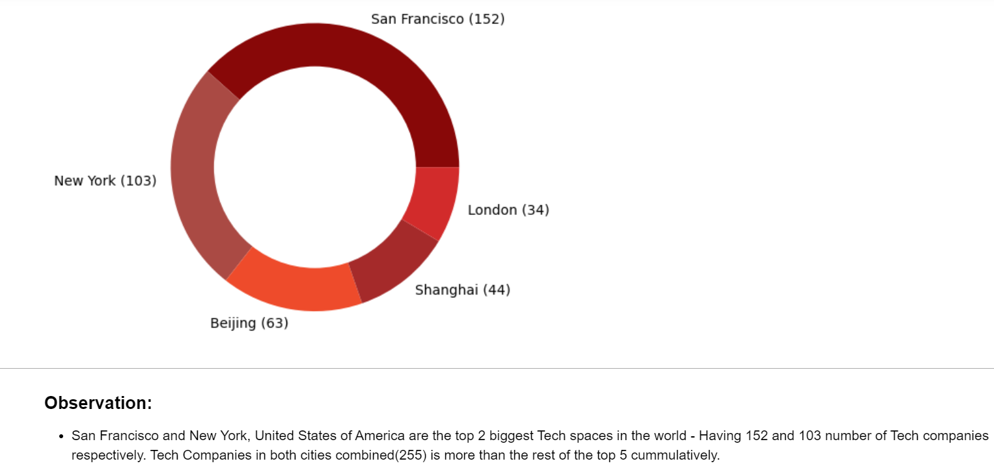
Top 5 Tech Hub Cities
Observation:
- San Francisco and New York, United States of America are the top 2 biggest Tech spaces in the world - Having 152 and 103 number of Tech companies respectively. Tech Companies in both cities combined(255) is more than the rest of the top 5 cumulatively.

Slide 5
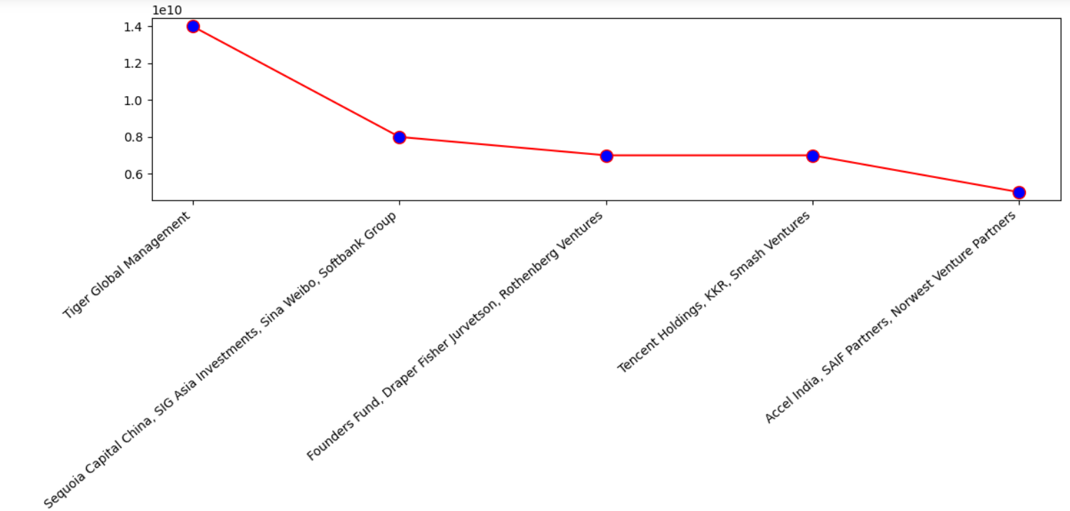
INVESTORS WHO INVESTED THE MOST
Observation:
- Tiger Global Management are the Top Spenders in the list of investments to the Unicorn Companies, at a staggering sum of USD14 Billion. They are just directly atop the most frequent investors in the list; Sequoia Capital China.

Slide 6
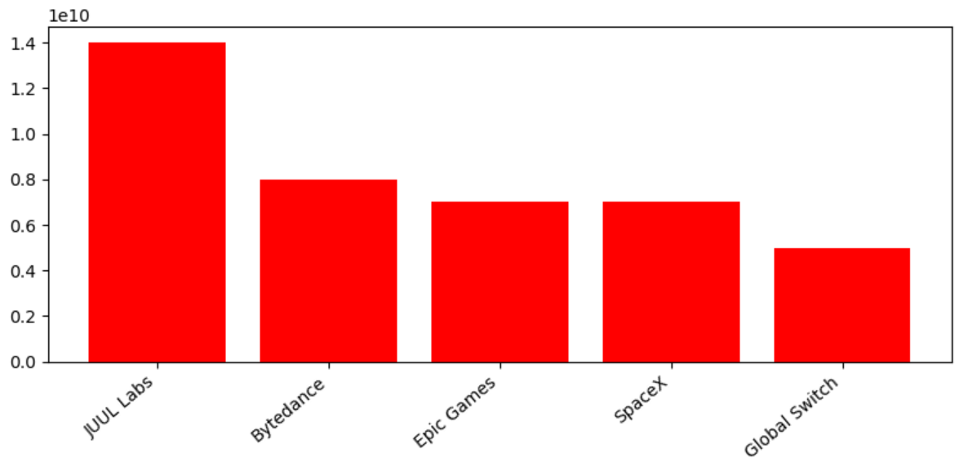
COMPANIES THAT RECEIVED THE MOST FUNDING AND THEIR R.O.I
Observation:
- JUUL Labs had the most funding at USD14 Billion, but only pulled off a 64% return on investment.
- Bytedance - makers of the popular Social Media Platform; 'Tik Tok' - on the other hand had about USD 8 Billion in funding and managed to produce a whooping 95% return on investment. Making it the Company with the highest ROI on this list of most funded Companies.

Slide 7
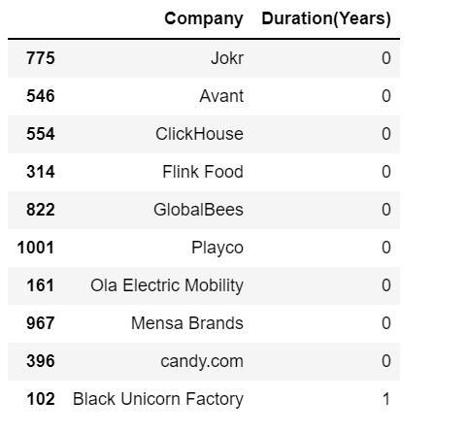
FASTEST COMPANIES TO ATTAIN UNICORN STATUS
Observation:
- It took Jokr and eight(8) other companies less than a year to achieve the Unicorn milestone, making them the fastest companies to achieve this feat in this list.
- Avant for example is an Artifical Intelligence company that was launched in November 2022, that then became a Unicorn before December that year.
- All of these companies have achieved the feat of a Unicorn as a result of being a Tech company or heavily incorporated Technology in their services.

Slide 8
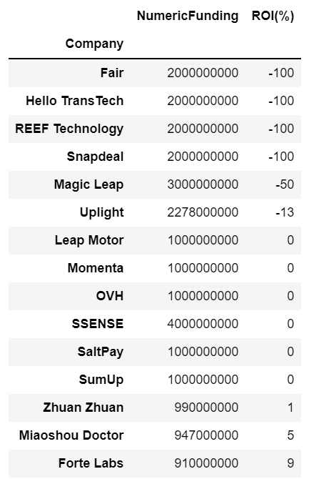
COMPANIES WITH THE WORST ROI
Observation:
15 of these companies are below the 10.5% standard on ROI for a succesful company, with 4 of these companies having a negative 100% ROI.

Slide 9
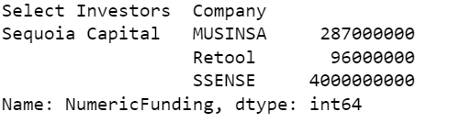
THE MOST FREQUENT INVESTOR IN UNICORN COMPANIES AND THEIR INVESTMENT
Observation:
From analysis, Sequoia Capital was found to be the most frequent investor by investing in three(3) Unicorn Companies. The companies and the amount invested is listed below:
1. MUSINSA - USD287 Million
2. Retool - USD96 Million
3. SSENSE - USD4 Billion
- It is important to note that according to the data, they may not be the sole investors of the said monies but are seen to be the most frequent of investors amongst the list of Unicorn Companies.

Slide 10
PROBLEM STATEMENT
15 of these Unicorn Companies so far recorded their Return on Investment well below the 10.5% ROI benchmark for a successful company: with 4 of these companies as low as negative 100%. In the absence of data on detailed financial indicators like their expenses (cost of operation), liabilities, assets and income over time periods etc. My strongest direction to focus on what the problem is, will be their costs of operation/service rendering(which involves logistics and delivery) amongst others.

Slide 11
RECOMMENDATIONS:
- Augment operational efficiency: This especially pertains to companies below the 10.5% benchmark for a successful company; They have to evaluate the company's operational processes and identify areas where efficiency can be improved upon. This can involve optimizing resource allocation and reducing unnecessary expenses. By improving the operational efficiency, the company can maximize the utilization of its resources and then potentially increase their profit.
- Assess investments: Review the company's investment decisions and analyze the factors contributing to the lower ROI. Evaluate whether the investments were made in viable and strategic initiatives. If necessary, adjust the investment strategy to focus on areas that have the potential to deliver higher returns.
- Improve Logistics and Service Delivery: In order to increase customer satisfaction, investments must be made to better company's service delivery. Investments in logistics as well to reduce the costs involved and make the system as seamless as possible.

